Slide 1
Henry Spencer Moore
30 July 1898 – 31 August 1986
Henry Moore was born in Castleford, Yorkshire, in 1898. He was a teacher and then joined the army before going to Leeds School of Art to study sculpture.
Moore was inspired by nature, sketching the hills and animals near where he lived and collecting stones, bones and tree roots. He used these twisted, bumpy forms to inspire his sculpture.
During WW2 he was commissioned by the War Artists Advisory Committee to draw the underground bomb shelters. The powerful scratchy dark drawings capture the feelings of anxiety at that time.

Slide 2
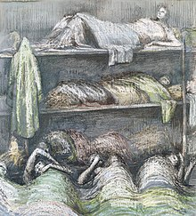
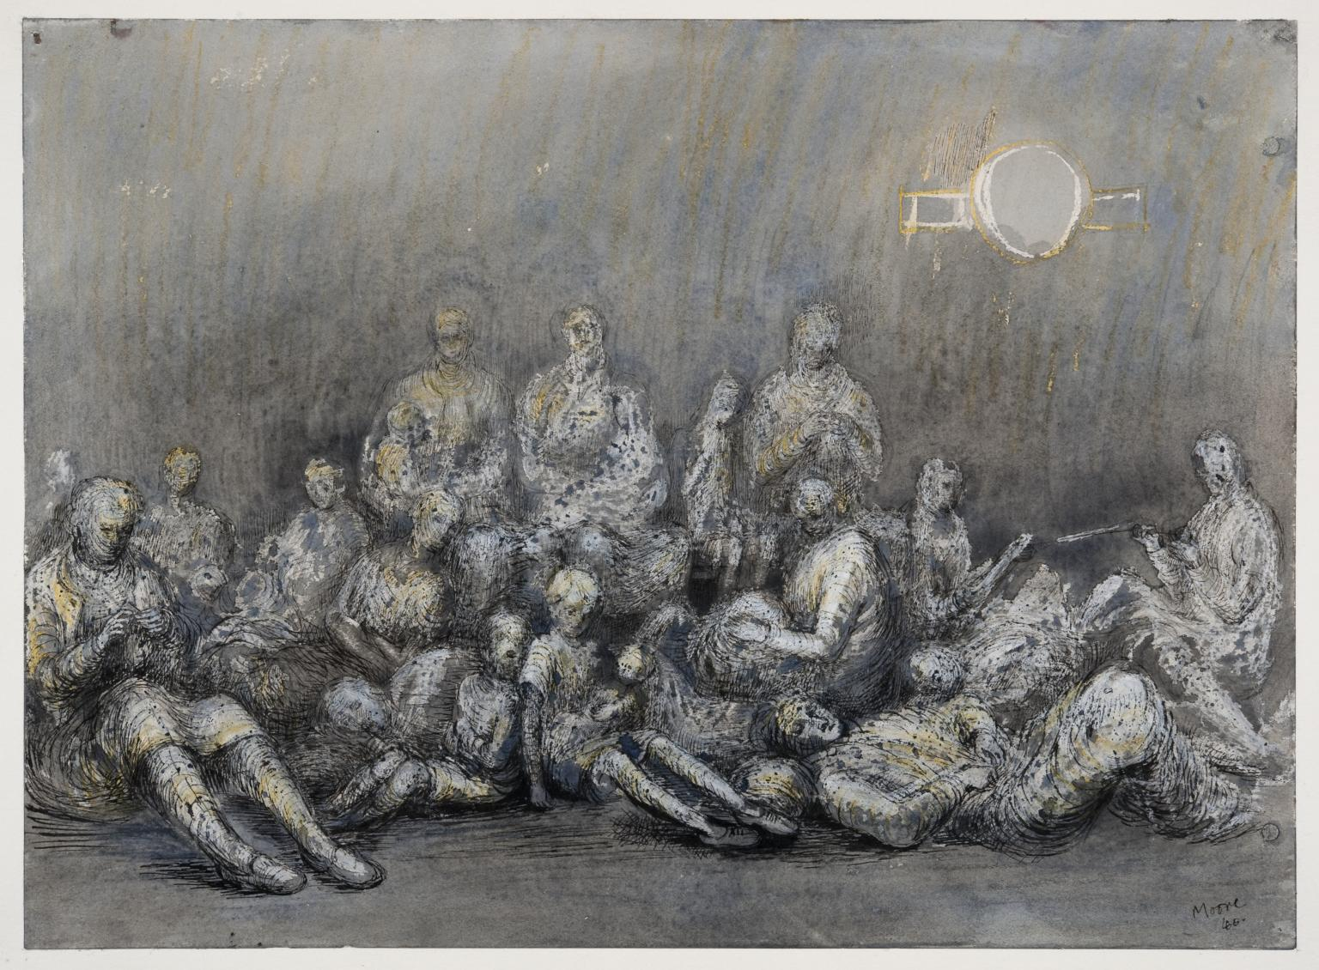
Tube Shelter Perspective 1941
This Photo by Unknown Author is licensed under CC BY-SA
This Photo by Unknown Author is licensed under CC BY-SA

Slide 3
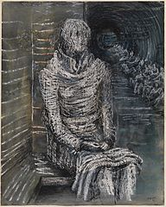
Moore wrote this in a letter on December 11th 1964
‘I hit upon this technique by accident, sometime before the war when doing a drawing to amuse a young niece of mine. I used some cheap wax crayons ( which she had bought from Woolworths) in combination with a wash of water colour, and found, of course, that the water-colours did not ‘take’ on the wax but only on the background.
I found also that if you use a light-coloured or even white wax crayon, then a dark depth of background can easily be produced by painting with dark water-colour over the whole sheet of paper’.
This Photo by Unknown Author is licensed under CC BY-SA

Slide 4
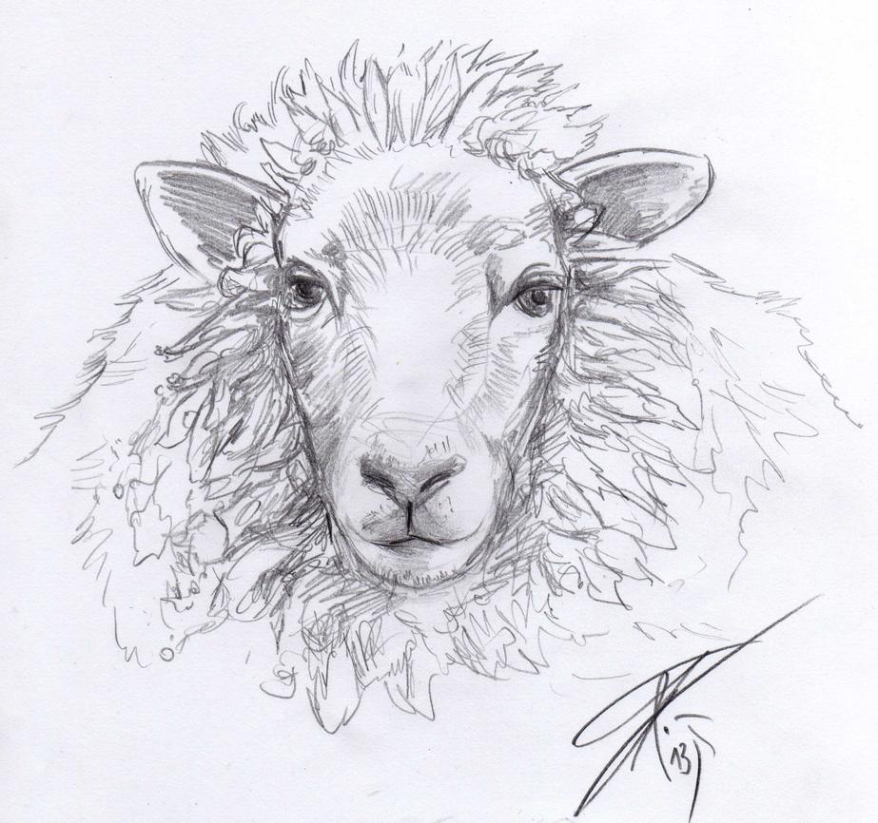
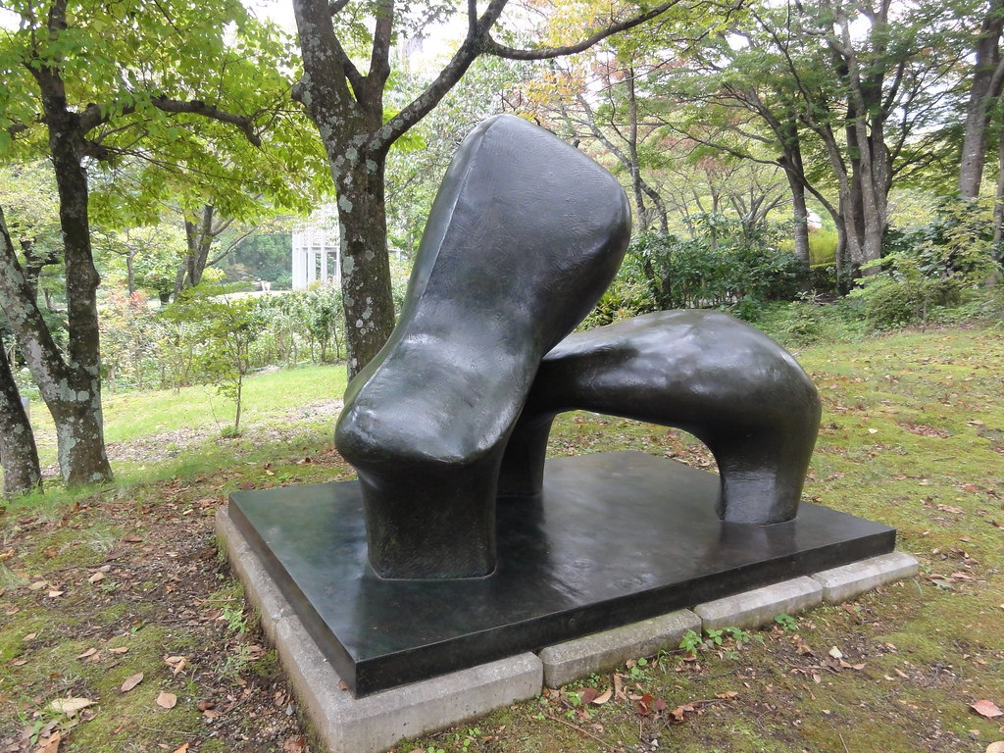
Moore also drew animals and nature around him. He drew a sketchbook full of sheep and these inspired his later sculptural work. Although nowadays he is prominently known for his abstract bronze sculptures, he was an excellent draughtsman.
This Photo by Unknown Author is licensed under CC BY
This Photo by Unknown Author is licensed under CC BY-SA-NC

Slide 5
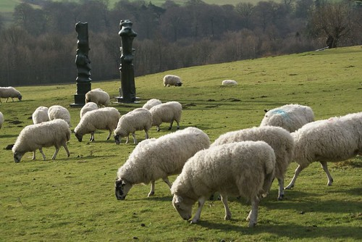
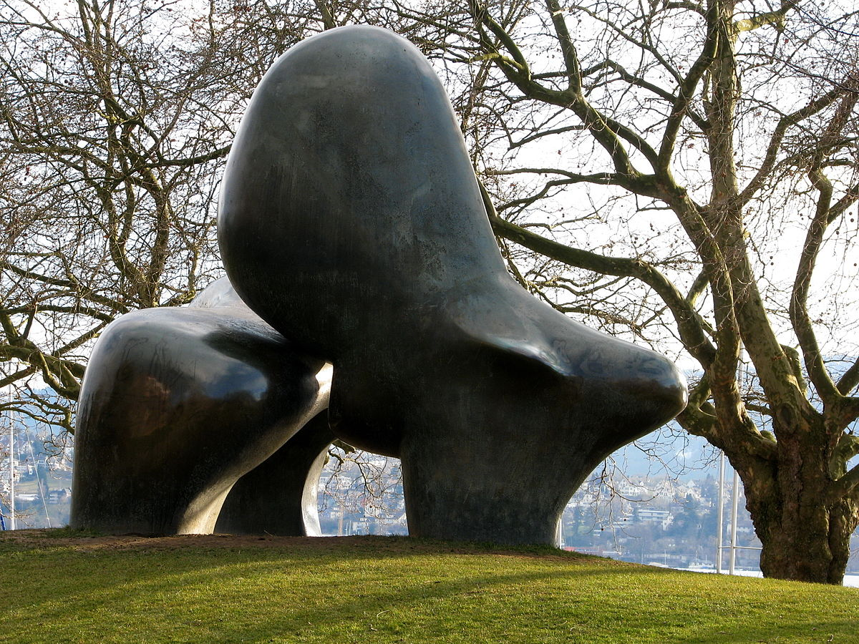
Moore observed sheep in the fields around where he lived , watching them from his studio at the bottom of the Perry Green grounds. In 1972 he presented many of his sheep drawings in a sketchbook to his daughter Mary.
This Photo by Unknown Author is licensed under CC BY-SA
This Photo by Unknown Author is licensed under CC BY-SA

Slide 6
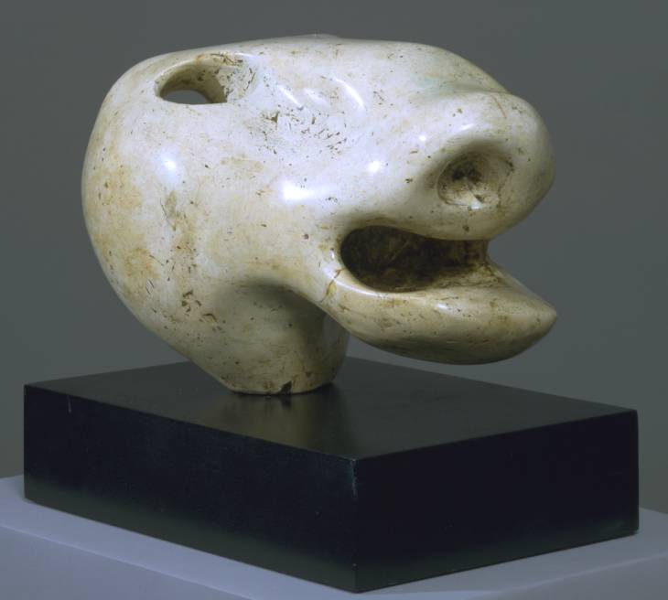
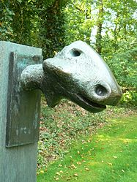
This Photo by Unknown Author is licensed under CC BY-SA
This Photo by Unknown Author is licensed under CC BY-NC-ND

Slide 7
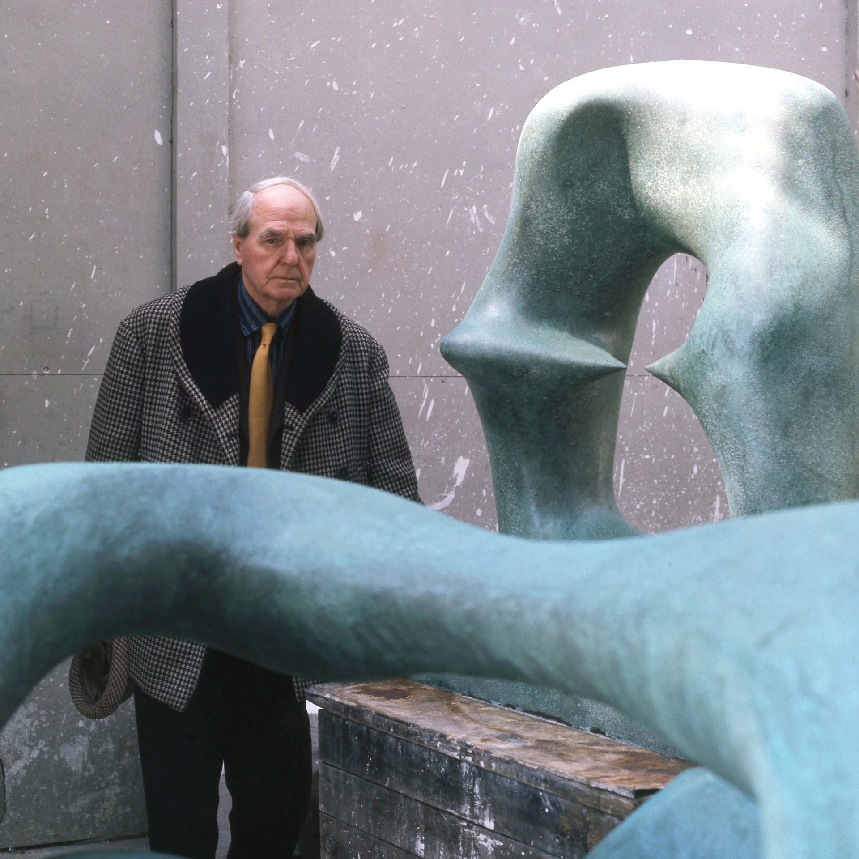
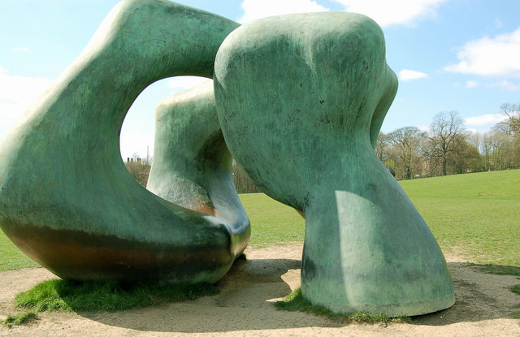
Henry Moore with some of his more familiar abstract scultures
This Photo by Unknown Author is licensed under CC BY-SA
This Photo by Unknown Author is licensed under CC BY-SA

Slide 8
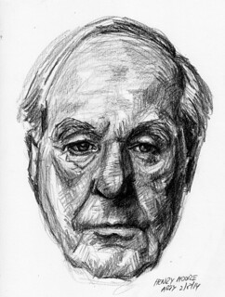
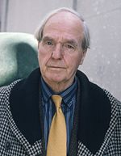
This Photo by Unknown Author is licensed under CC BY-SA
This Photo by Unknown Author is licensed under CC BY-SA-NC

